Slide 1
UNIDAD DOS - ACTIVIDAD UNO
MOMENTO INDEPENDIENTE

Slide 2
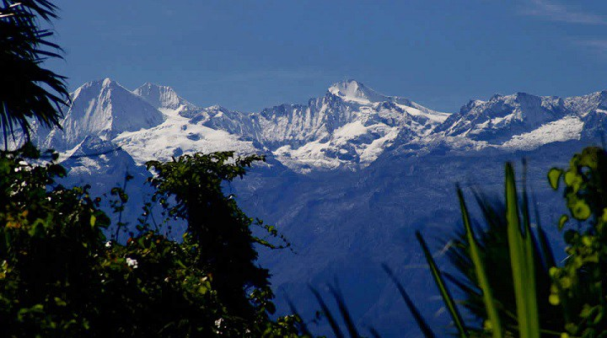
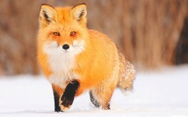
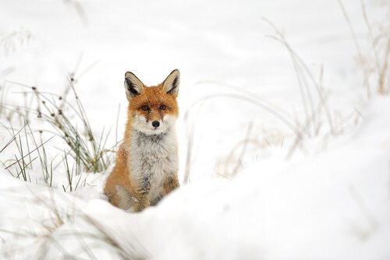
Monday Lunes | Tuesday Martes | Wednesday Miércoles | Thursday Jueves | Friday Viernes | Saturday Sábado | Sunday Domingo
 |  | 1 one | 2 two | 3 three | 4 four | 5 five
6 six | 7 seven | 8 eigth | 9 nine | 10 ten | 11 eleven | 12 twelve
13 thirteen | 14 fourteen | 15 fifteen | 16 sixteen | 17 seventeen | 18 eighteen | 19 nineteen
20 twenty | 21 Twenty one | 22 Twenty two | 23 Twenty three | 24 Twenty four | 25 Twenty five | 26 Twenty six
27 Twenty seven | 28 Twenty eigth | 29 Twenty nine | 30 thirty | 31 Thirty one
May de 2019
Mayo de 2019
Red fox
he is Omnivore, in freeing his period of life he is 2 - 5 years old, he has a Height: 35 - 50 cm (Adult, On the shoulder) Length: 45 - 90 cm (Adult, without glue) Body Mass: 2.2 - 14 kg (Adult)
International Mammal Day– día internacional del Mamífero

Slide 3
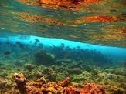
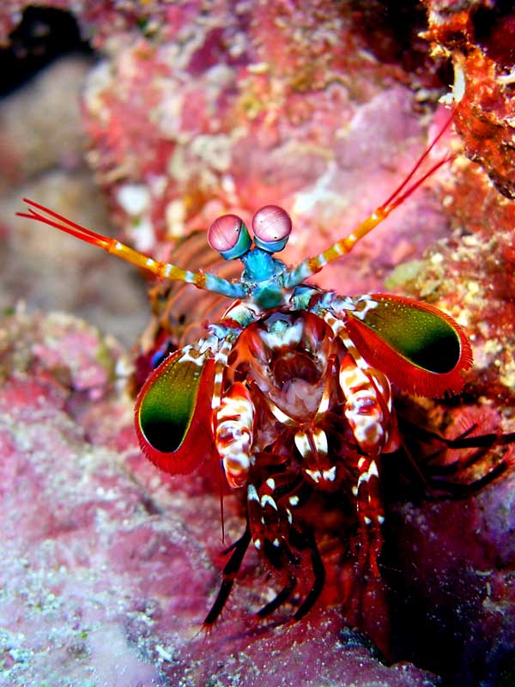

Monday Lunes | Tuesday Martes | Wednesday Miércoles | Thursday Jueves | Friday Viernes | Saturday Sábado | Sunday Domingo
1 one | 2 two | 3 three | 4 four | 5 five | 6 six | 7 seven
8 eigth | 9 nine | 10 ten | 11 eleven | 12 twelve | 13 thirteen | 14 fourteen
15 fifteen | 16 sixteen | 17 seventeen | 18 eighteen | 19 nineteen | 20 twenty | 21 Twenty one
22 Twenty two | 23 Twenty three | 24 Twenty four | 25 Twenty five | 26 Twenty six | 27 Twenty seven | 28 Twenty eigth
29 Twenty nine | 30 thirty | 29 Twenty nine | 31 Thirty one | 31 Thirty one
July de 2019
julio de 2019
Camarón mantis
he is Malacostraca e, in freeing his period of life he is 1 – 6 años years old, Scientific name: Caridea Class: Malacostraca Animalia Kingdom Number of eggs: 50,000 - 1,000,000 Phylum: Arthropoda Length: 1.2 - 30 cm
International Malacostraca Day– día internacional del Malacostraca

Slide 4
Hola mi nombre es Nevardo
Mi animal favorito es el tigre, porque los tigres son muy hermoso y fuertes, hay diferentes tipos de tigres. me gustan todos, aunque hay personas que les tienen miedo. pero si logras tener uno bien domado sera un super buen amigo
Mi tigre es muy grande tiene mi tamaño, muy amable, duerme todo el día y come mucho pero mucho. es un tigre muy hermoso

Slide 5
Hello my name is Nevardo
My favorite animal is the tiger, because the tigers are very beautiful and strong, there are different types of tigers. I like them all, although there are people who are afraid of them. but if you manage to have one well tamed it will be a super good friend
My tiger is very big, it has my size, it is very kind, it sleeps all day and it eats a lot but a lot. It is a very beautiful tiger

Slide 6

AUDIO

